Slide 1
AHI Research & Architecture
Intro

Slide 2
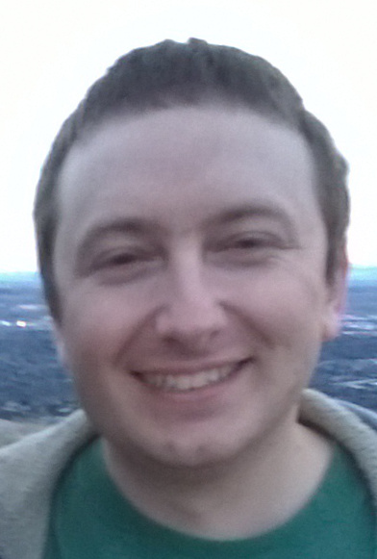
Hello
Derek Bliss
Lab Specialist, 13th year making games @ FS
Content creator outside of university.
Pixel art, model kitbashing, small scoped games.
I like playing games, watching youtube, and taking naps.
I know a lot about making games, so feel free to ask.
Add me to your discord, @ DerekBliss#6419. Feel free to direct message me.

Slide 3
Your Goal
Realize you don't know jack, and that you also know a lot. The first can free you up to learn a lot. The later can keep you from learning anything new.
Make something kickass you'd be happy to show people.

Slide 4
My goal
Rockstars <--- The Middle Majority <--- The Lost
Expose you to, and help you replicate awesomeness.
Help you understand what it is like to make games with other people.

Slide 5
Gifts
Write down everything - Keep notepad / Evernote / Google Docs open and note everything. You will never hold in your internal memory all the things that need to be done. Learn to use external memory
Sort your time out - Use a calendar, Siri, post it notes, whatever.
Balance the tasks and your life.
Observe your environment - Take note of those that are able to get shit done, how do they do? As long as they don't go about by cheating, it may be worth stealing how they do.
People with experience; you are not the dictator of the group, you have wisdom to impart, which is hard to do when everyone thinks you are a dick.
All the stuff learned in SWE isn't just for a grade. Pay attention, take notes on it, be ready to explain why and when it is good to use it and where. Especially for you game.
There is potential that every Course Director involved in the midterm will influence or even outright change parts of the project. That’s alright.
You will not be spending the next 3 months creating you own unique epic interactive experience. The focus of this midterm is not to reinvent the wheel.

Slide 6
SWE Knowledge
Day 1:
+2D basics - Game Objects, Screen and world space, Collision, Version control, Scripting, Layers, Camera, UI canvas, Scenes.
Day 2:
+2D animation - Animation, Events, Finite State Machine (FSM), Transitions, Sprites, Prefabs, Camera Animation, FSM sub states, Audio, Caching components and object pools, Debugging (in C++), Exporting(???).
Day 3:
+Messages and Events - SendMessage(), Delegates, Design Patterns (Focus on Mediator, Focus on Observer), Parallelism - Invoke & Coroutines

Slide 7
Question to ask yourself
What is your main priority for the next 3 months? How are you proving that?

